Slide 1
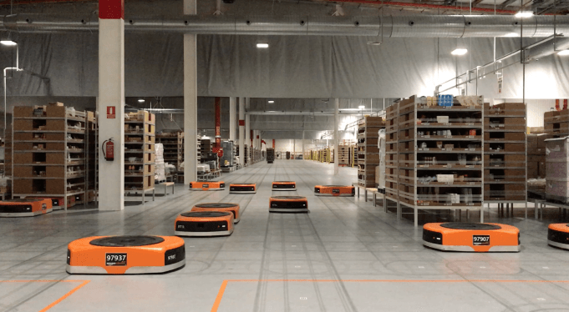
Amazon Robotics machines in a Amazon warehouse
Tests on the map and Path planning for a single robot
Luca Marseglia

Slide 2
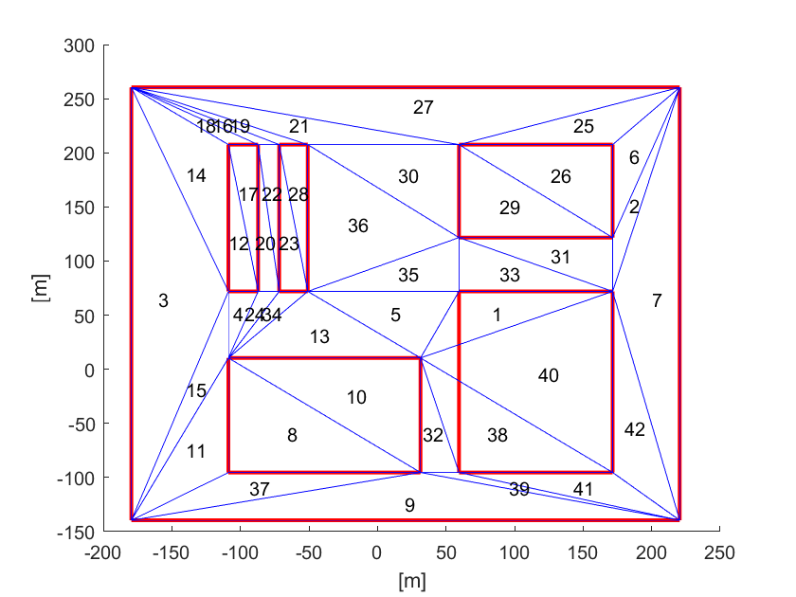
Tests on the map: Plotting the path
First, some tests on the triangulation were made:
2024 July | Slide 2

Slide 3
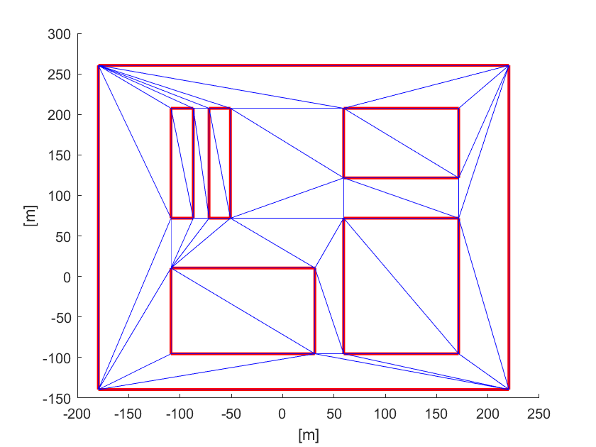
Tests on the map: Plotting the path
By also learning how to force it when triangles cross edges:
2024 July | Slide 3

Slide 4
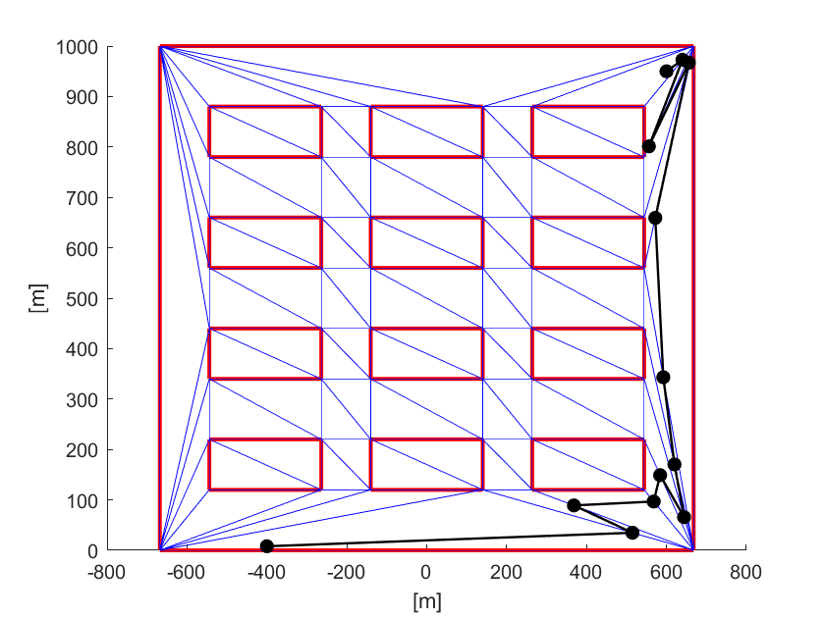
Tests on the map: Plotting the path
Then a first test consisted in the simple plot of the path to start to familiarize with the map:
2024 July | Slide 4

Slide 5
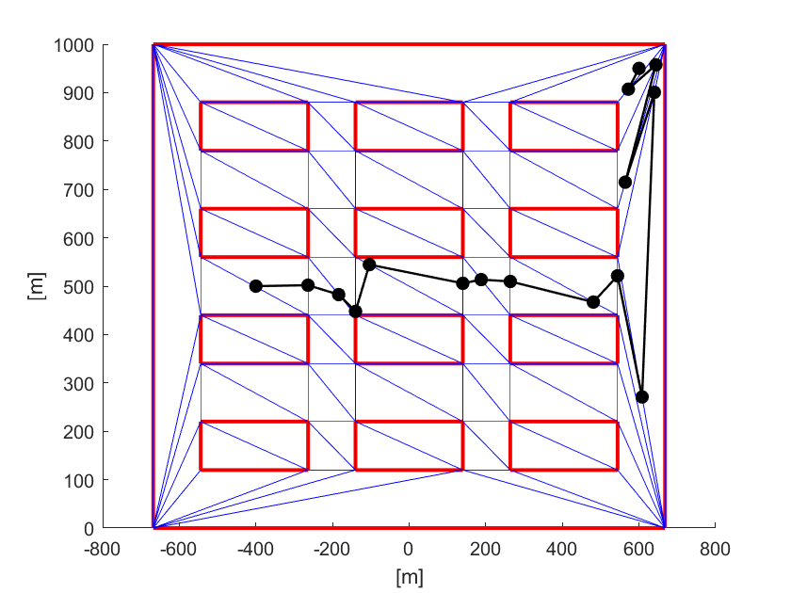
Tests on the map: Plotting the path
Then the start and goal point were changed:
2024 July | Slide 5

Slide 6
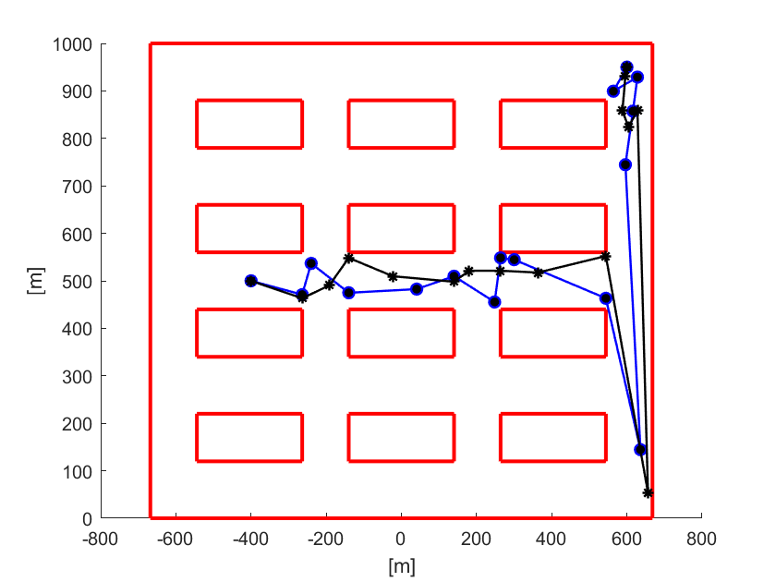
Tests on the map: Plotting multiple paths
Then multiple paths were plotted and the triangulation was removed:
2024 July | Slide 6

Slide 7
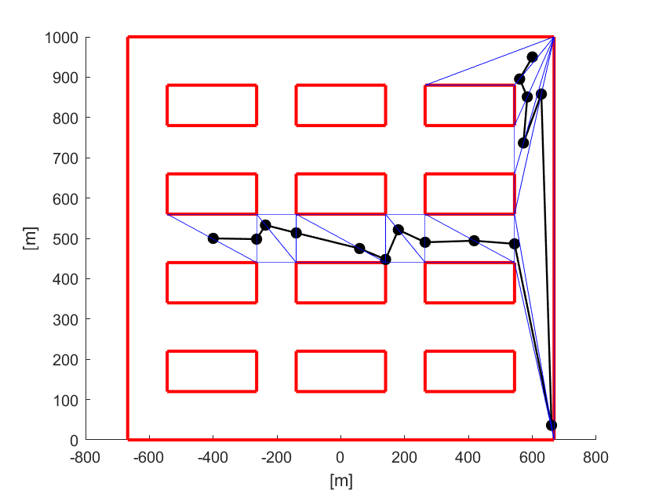
Tests on the map: Plotting multiple paths
Then the triangle sequence was highlighted:
2024 July | Slide 7

Slide 8
Tests on the map: Interpolation of the path
The problem is to let the robot follow the trajectory computed along the given path.
The path is a set of relevant points produced by the DT-RRT* algorithm.
The trajectory contains the robot’s position for each time step, in terms of x and y coordinates.
The problem can be split into two sub-problems:
Interpolation of the path: The whole path is interpolated so that it is divided into a fixed number of samples.
Parameterization of the samples with time: A time law is computed so that to each time step is associated a sample of the path
2024 July | Slide 8

Slide 9
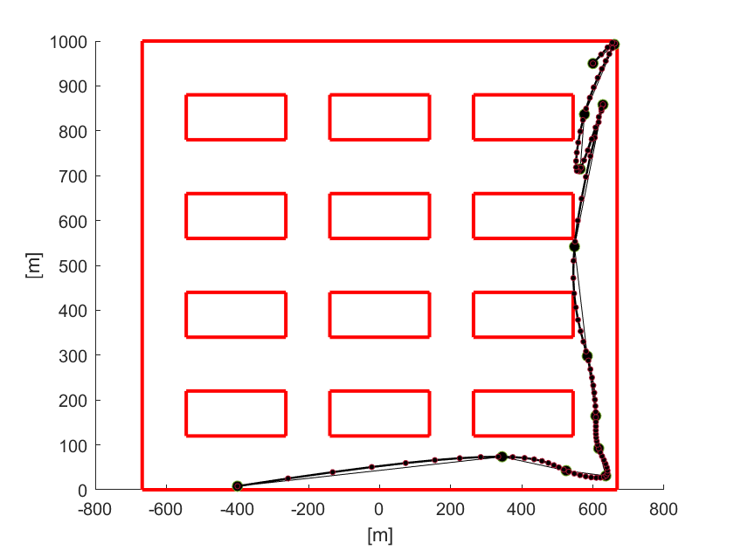
Path planning 1: Interpolation of the path
A generated path from [-400, 8] to [600, 950] was saved and then interpolated with the spline method and 100 samples.
2024 July | Slide 9

Slide 10
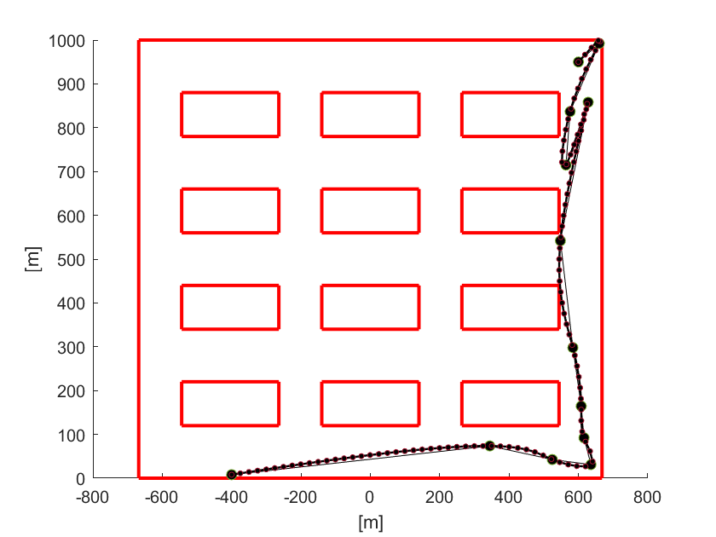
Path planning 1: Interpolation of the path
Issue: The simple interpolation from Matlab generates a number of samples that is more dense in correspondence of turning points. Such an irregular placement of the samples may cause problems with the timing law.
For this reason, starting from the interpolated curve, the samples have been re-placed evenly:
2024 July | Slide 10

Slide 11
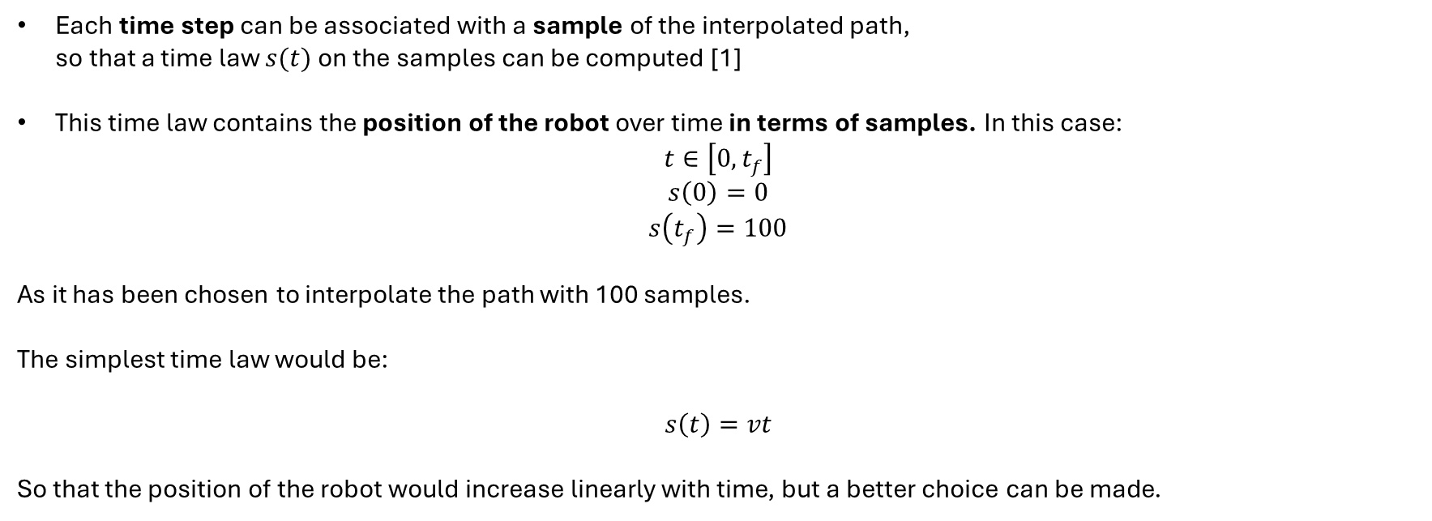
Path planning 2: Parameterization with time
Each time step can be associated with a sample of the interpolated path,
so that a time law $s(t)$ on the samples can be computed [1]
This time law contains the position of the robot over time in terms of samples. In this case:
$$t∈\left[0,t_{f}\right]$$
$$s\left(0\right)=0$$
$$s\left(t_{f}\right)=100$$
As it has been chosen to interpolate the path with 100 samples.
The simplest time law would be:
$$s\left(t\right)=vt$$
So that the position of the robot would increase linearly with time, but a better choice can be made.
2024 July | Slide 11

Slide 12
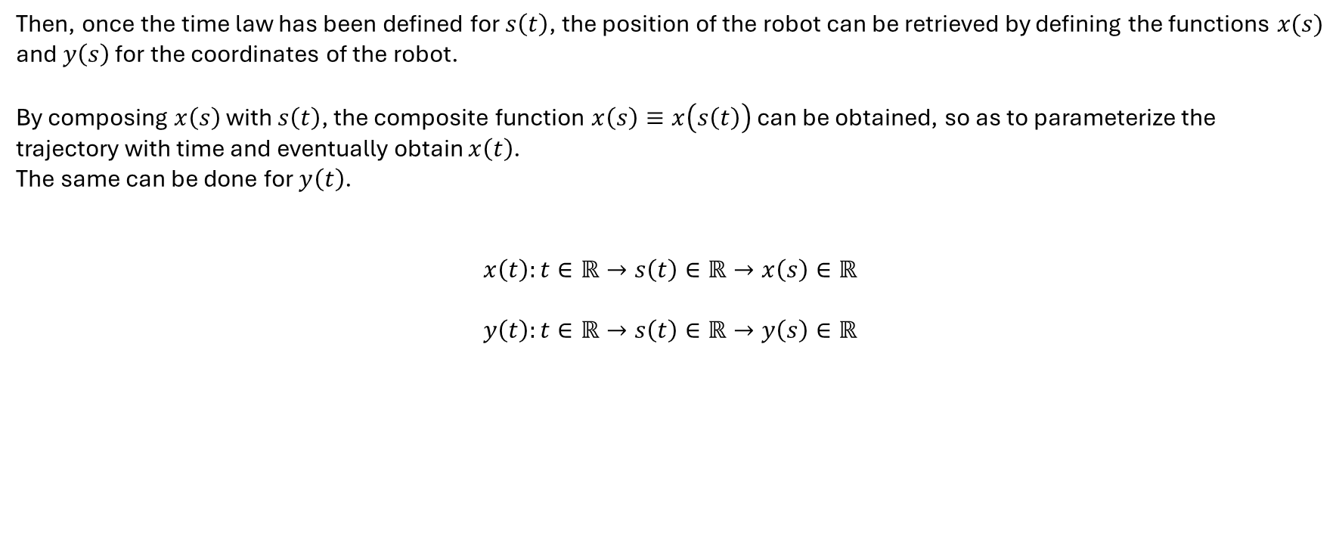
Path planning 2: Parameterization with time
Then, once the time law has been defined for $s\left(t\right)$, the position of the robot can be retrieved by defining the functions $x(s)$ and $y\left(s\right)$ for the coordinates of the robot.
By composing $x\left(s\right)$ with $s\left(t\right)$, the composite function $x\left(s\right)≡x\left(s\left(t\right)\right)$ can be obtained, so as to parameterize the trajectory with time and eventually obtain $x\left(t\right)$.
The same can be done for $y\left(t\right)$.
$$x\left(t\right):t∈ℝ→s\left(t\right)∈ℝ→x\left(s\right)∈ℝ$$
$$y\left(t\right):t∈ℝ→s\left(t\right)∈ℝ→y\left(s\right)∈ℝ$$
2024 July | Slide 12

Slide 13

Path planning 2: Time law and implementation
The arc length $s\left(t\right)$ is computed between two points of the path, $p_{i−1}$ and $p_{i}$, with $t∈\left[t_{i−1},t_{i}\right]$:
$$s\left(t\right)=\frac{1}{2}a_{T}t^{2}+v_{i−1}t$$
$$a_{T}=\frac{v_{i}−v_{i−1}}{t_{i}−t_{i−1}}$$
In order for the arc length to be computed, the code only needs in input:
The points of the path
The velocities with which the robot must cross each of these points
2024 July | Slide 13

Slide 14
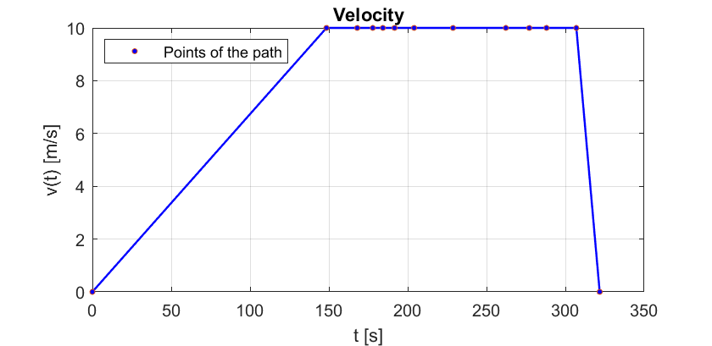
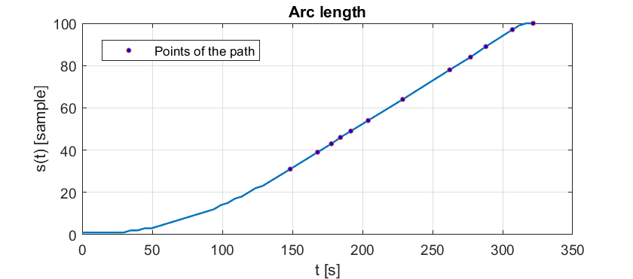
Path planning 2: Results
Parameters:
N. of samples | Path | Velocities
100 | 13 points from [-400, 8] to [600, 950] | [0 10 10 10 10 10 10 10 10 10 10 10 0]
2024 July | Slide 14

Slide 15
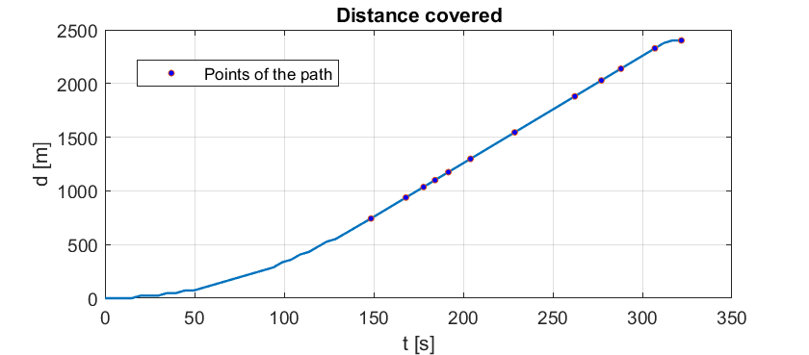
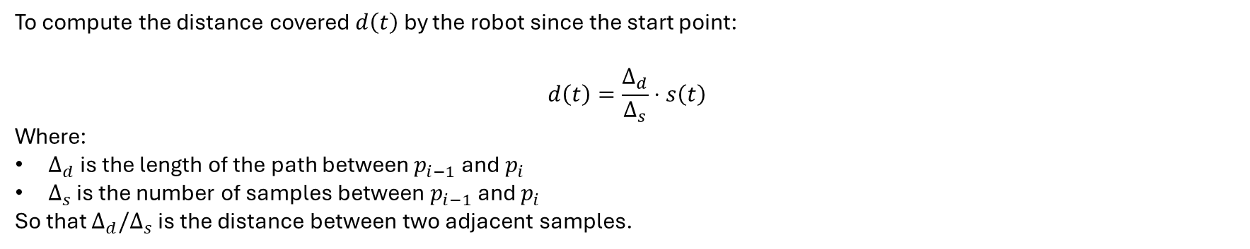
Path planning 2: Results
To compute the distance covered $d\left(t\right)$ by the robot since the start point:
$$d\left(t\right)=\frac{Δ_{d}}{Δ_{s}}⋅s\left(t\right)$$
Where:
$Δ_{d}$ is the length of the path between $p_{i−1}$ and $p_{i}$
$Δ_{s}$ is the number of samples between $p_{i−1}$ and $p_{i}$
So that $Δ_{d}/Δ_{s}$ is the distance between two adjacent samples.
2024 July | Slide 15

Slide 16
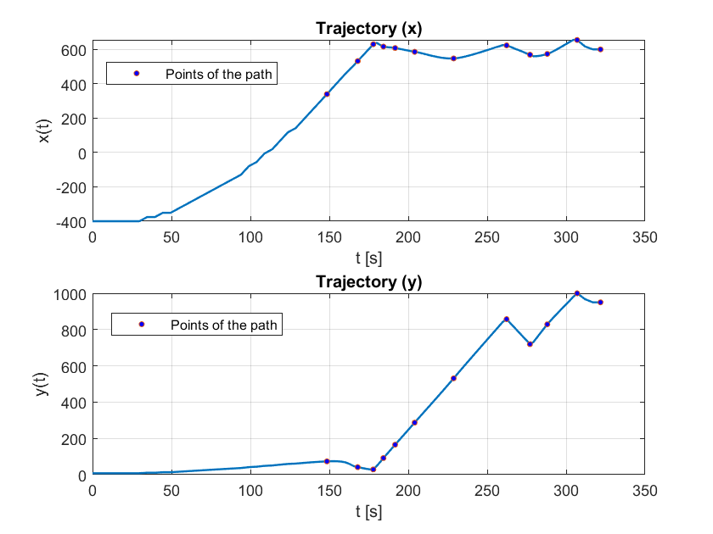

Path planning 2: Results
Once the arc length $s\left(t\right)$ is computed, the trajectory is obtained by computing $x\left(s\left(t\right)\right)$ and $y\left(s\left(t\right)\right)$:
2024 July | Slide 16

Slide 17
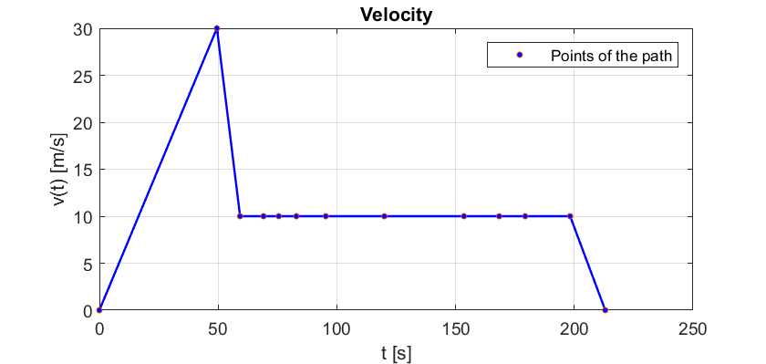
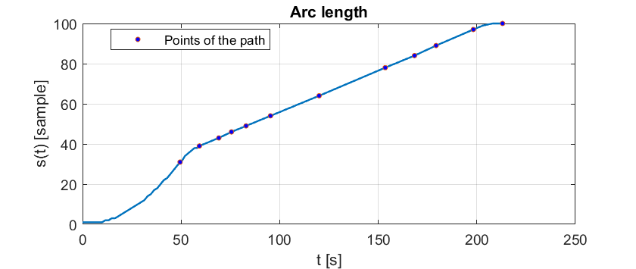
Path planning 2: Results
Parameters:
N. of samples | Path | Velocities
100 | 13 points from [-400, 8] to [600, 950] | [0 30 10 10 10 10 10 10 10 10 10 10 0]
2024 July | Slide 17

Slide 18
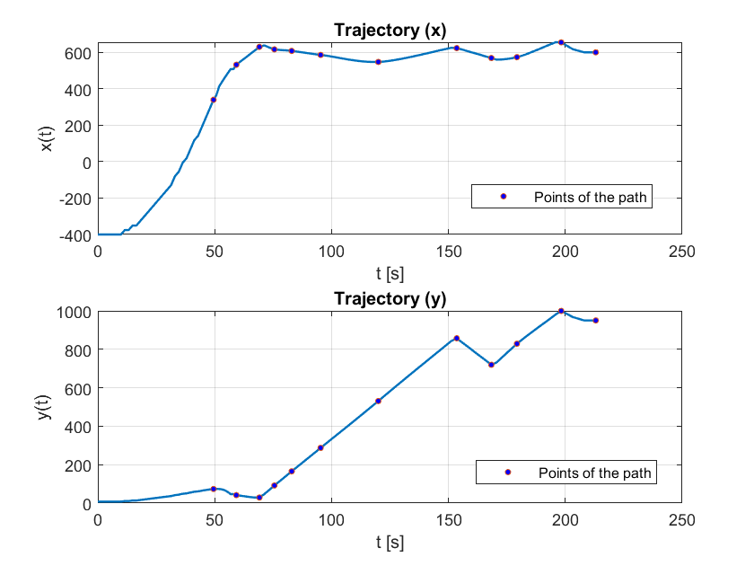
Path planning 2: Results
2024 July | Slide 18

Slide 19
Future work
Understanding charts production
Understaing how to generate multiple trajectories from different starting points, with the same goal point, with a single program
Path planning for multiple robots starting from the same point and with the same goal point
Path planning for multiple robots starting from a different point but with the same goal point: how to proceed?
2024 July | Slide 19

Slide 20
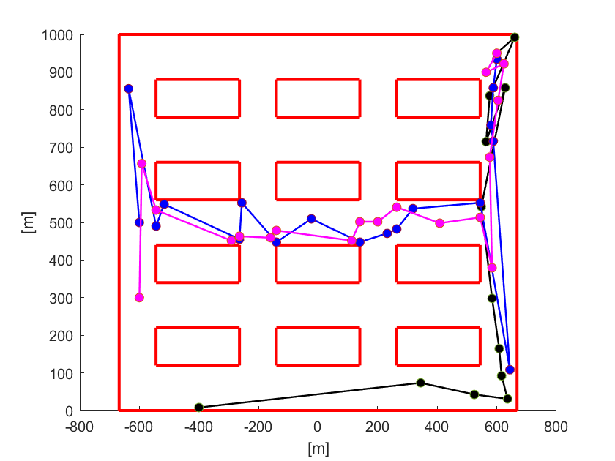
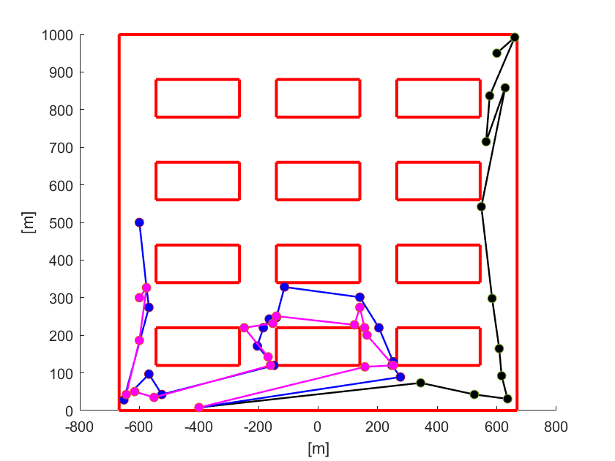
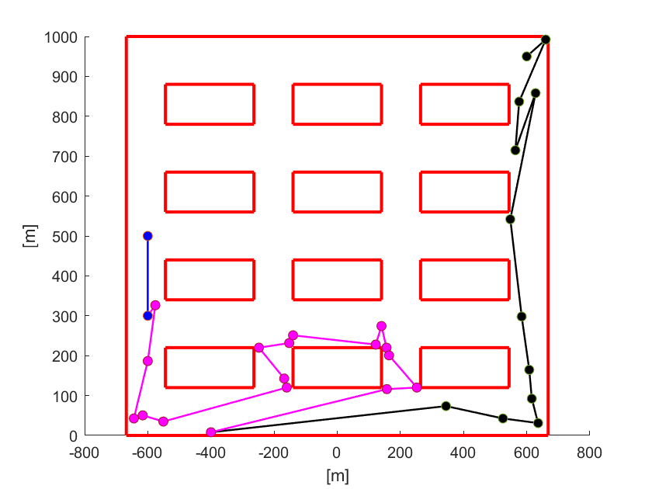
Doubts and issues
How to proceed with the path planning for multiple robots?
Make all the robots go to the start point of a chosen robot, and then follow its path
Make all the robots align to the path of a chosen robot, starting from their existing path
First, simpler proposed approach:
2024 July | Slide 20

Slide 21
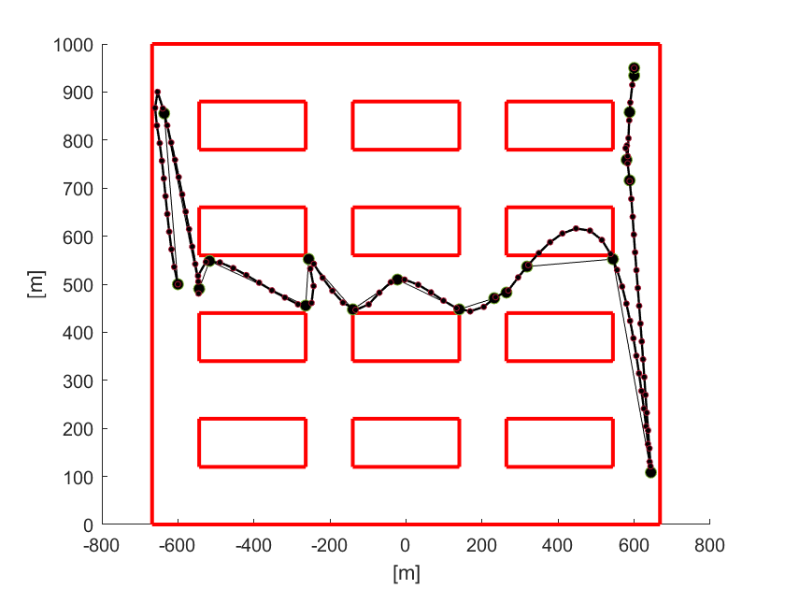
Doubts and issues
Is the interpolation a concerning part?
2024 July | Slide 21

